Slide 1
Solutions Assignment 1

Slide 2
Assignment 1 questions
The paper today brings the news that Equifax, a credit reporting agency was hacked and the records of 143 Million Americans have been compromised. These are especially sensitive records because they include credit information as well as personal identification.
Draw a sequence diagram as the one I showed for the Sony attack, describing this attack. Show clearly the possible misuses of information. Find information in the Internet and indicate your sources (URLs).
Analyze critically why this attack was possible; that is, vulnerabilities in the system.
Show how the attack could have been prevented, indicating policies and mechanisms that could have stopped or mitigated the attack.

Slide 3
Context
To fully understand an attack we need to analyze the context of the hacked institution, its assets, and types of management people.
They offer credit and demographic related data and services to business, and they sell credit monitoring and fraud-prevention services directly to consumers.
Equifax is an old institution and they evolved from using paper records to computer and to the Internet. It seems that their managers are not up to date in technology and based on their past record they don’t seem to care much about their record holders.
Equifax was the subject of more than 57,000 consumer complaints to the Consumer Financial Protection Bureau from October 2012 to September 17, 2017 with most complaints relating to incomplete, inaccurate, outdated, or misattributed information held by the company.
This explains the use of unqualified technical people, lack of policies to protect their information, and general attitude about their record holders, who are not really their customers, they are their product.

Slide 4
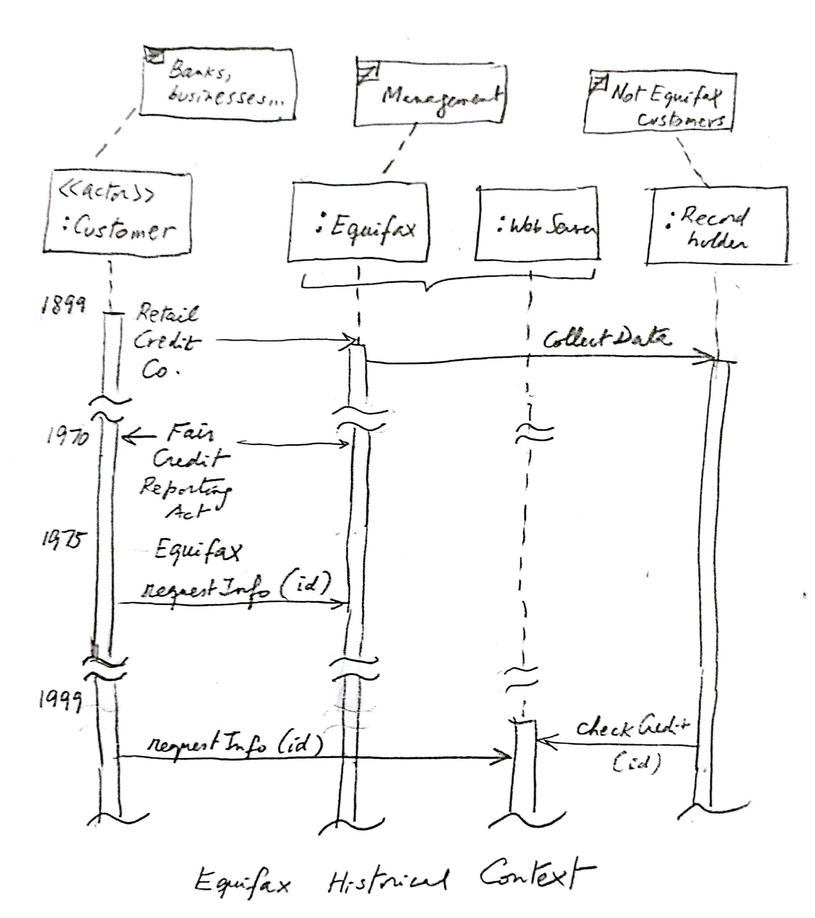

Slide 5
Fair Credit Reporting Act
The, 15 U.S.C. § 1681 (“FCRA”) is U.S. Federal Government legislation enacted to promote the accuracy, fairness, and privacy of consumer information contained in the files of consumer reporting agencies.
It was intended to protect consumers from the willful and/or negligent inclusion of inaccurate information in their credit reports.
To that end, the FCRA regulates the collection, dissemination, and use of consumer information, including consumer credit information.
Together with the Fair Debt Collection Practices Act ("FDCPA"), the FCRA forms the foundation of consumer rights law in the United States. It was originally passed in 1970, and is enforced by the US Federal Trade Commission, the Consumer Financial Protection Bureau and private litigants.

Slide 6
The attacks
The next two slides show the attack sequence, the third slide combines the other two for better perspective.
Note that we need to include the people involved because they are participating in the attack as attackers or victims.
The diagrams are complemented with numbered notes that explain some points in more detail.

Slide 7
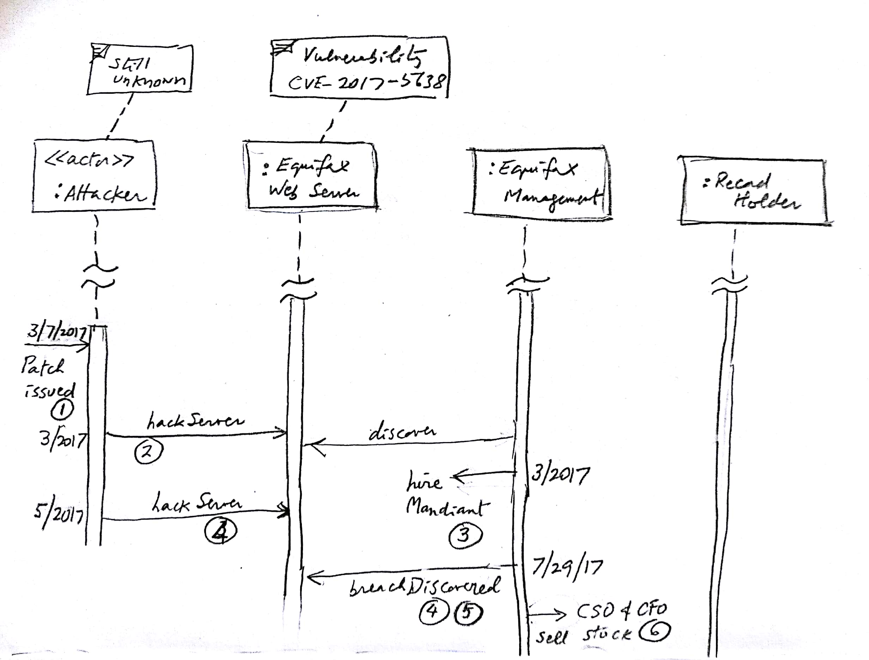

Slide 8
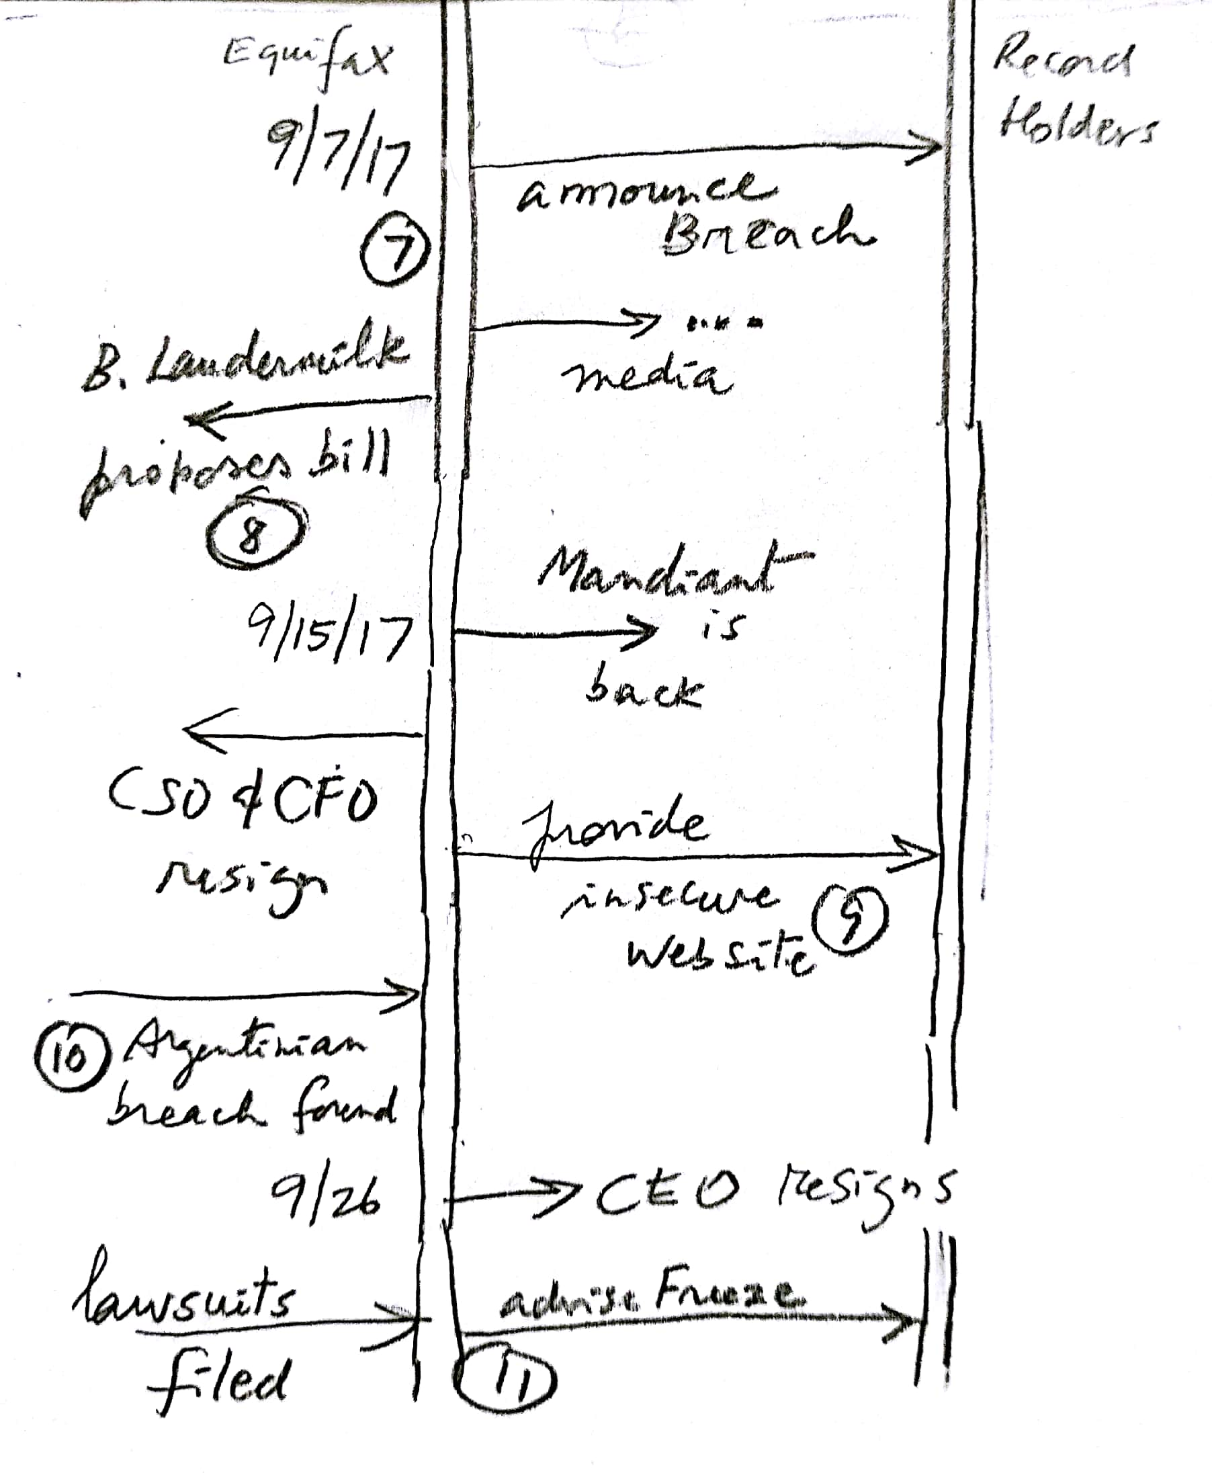

Slide 9
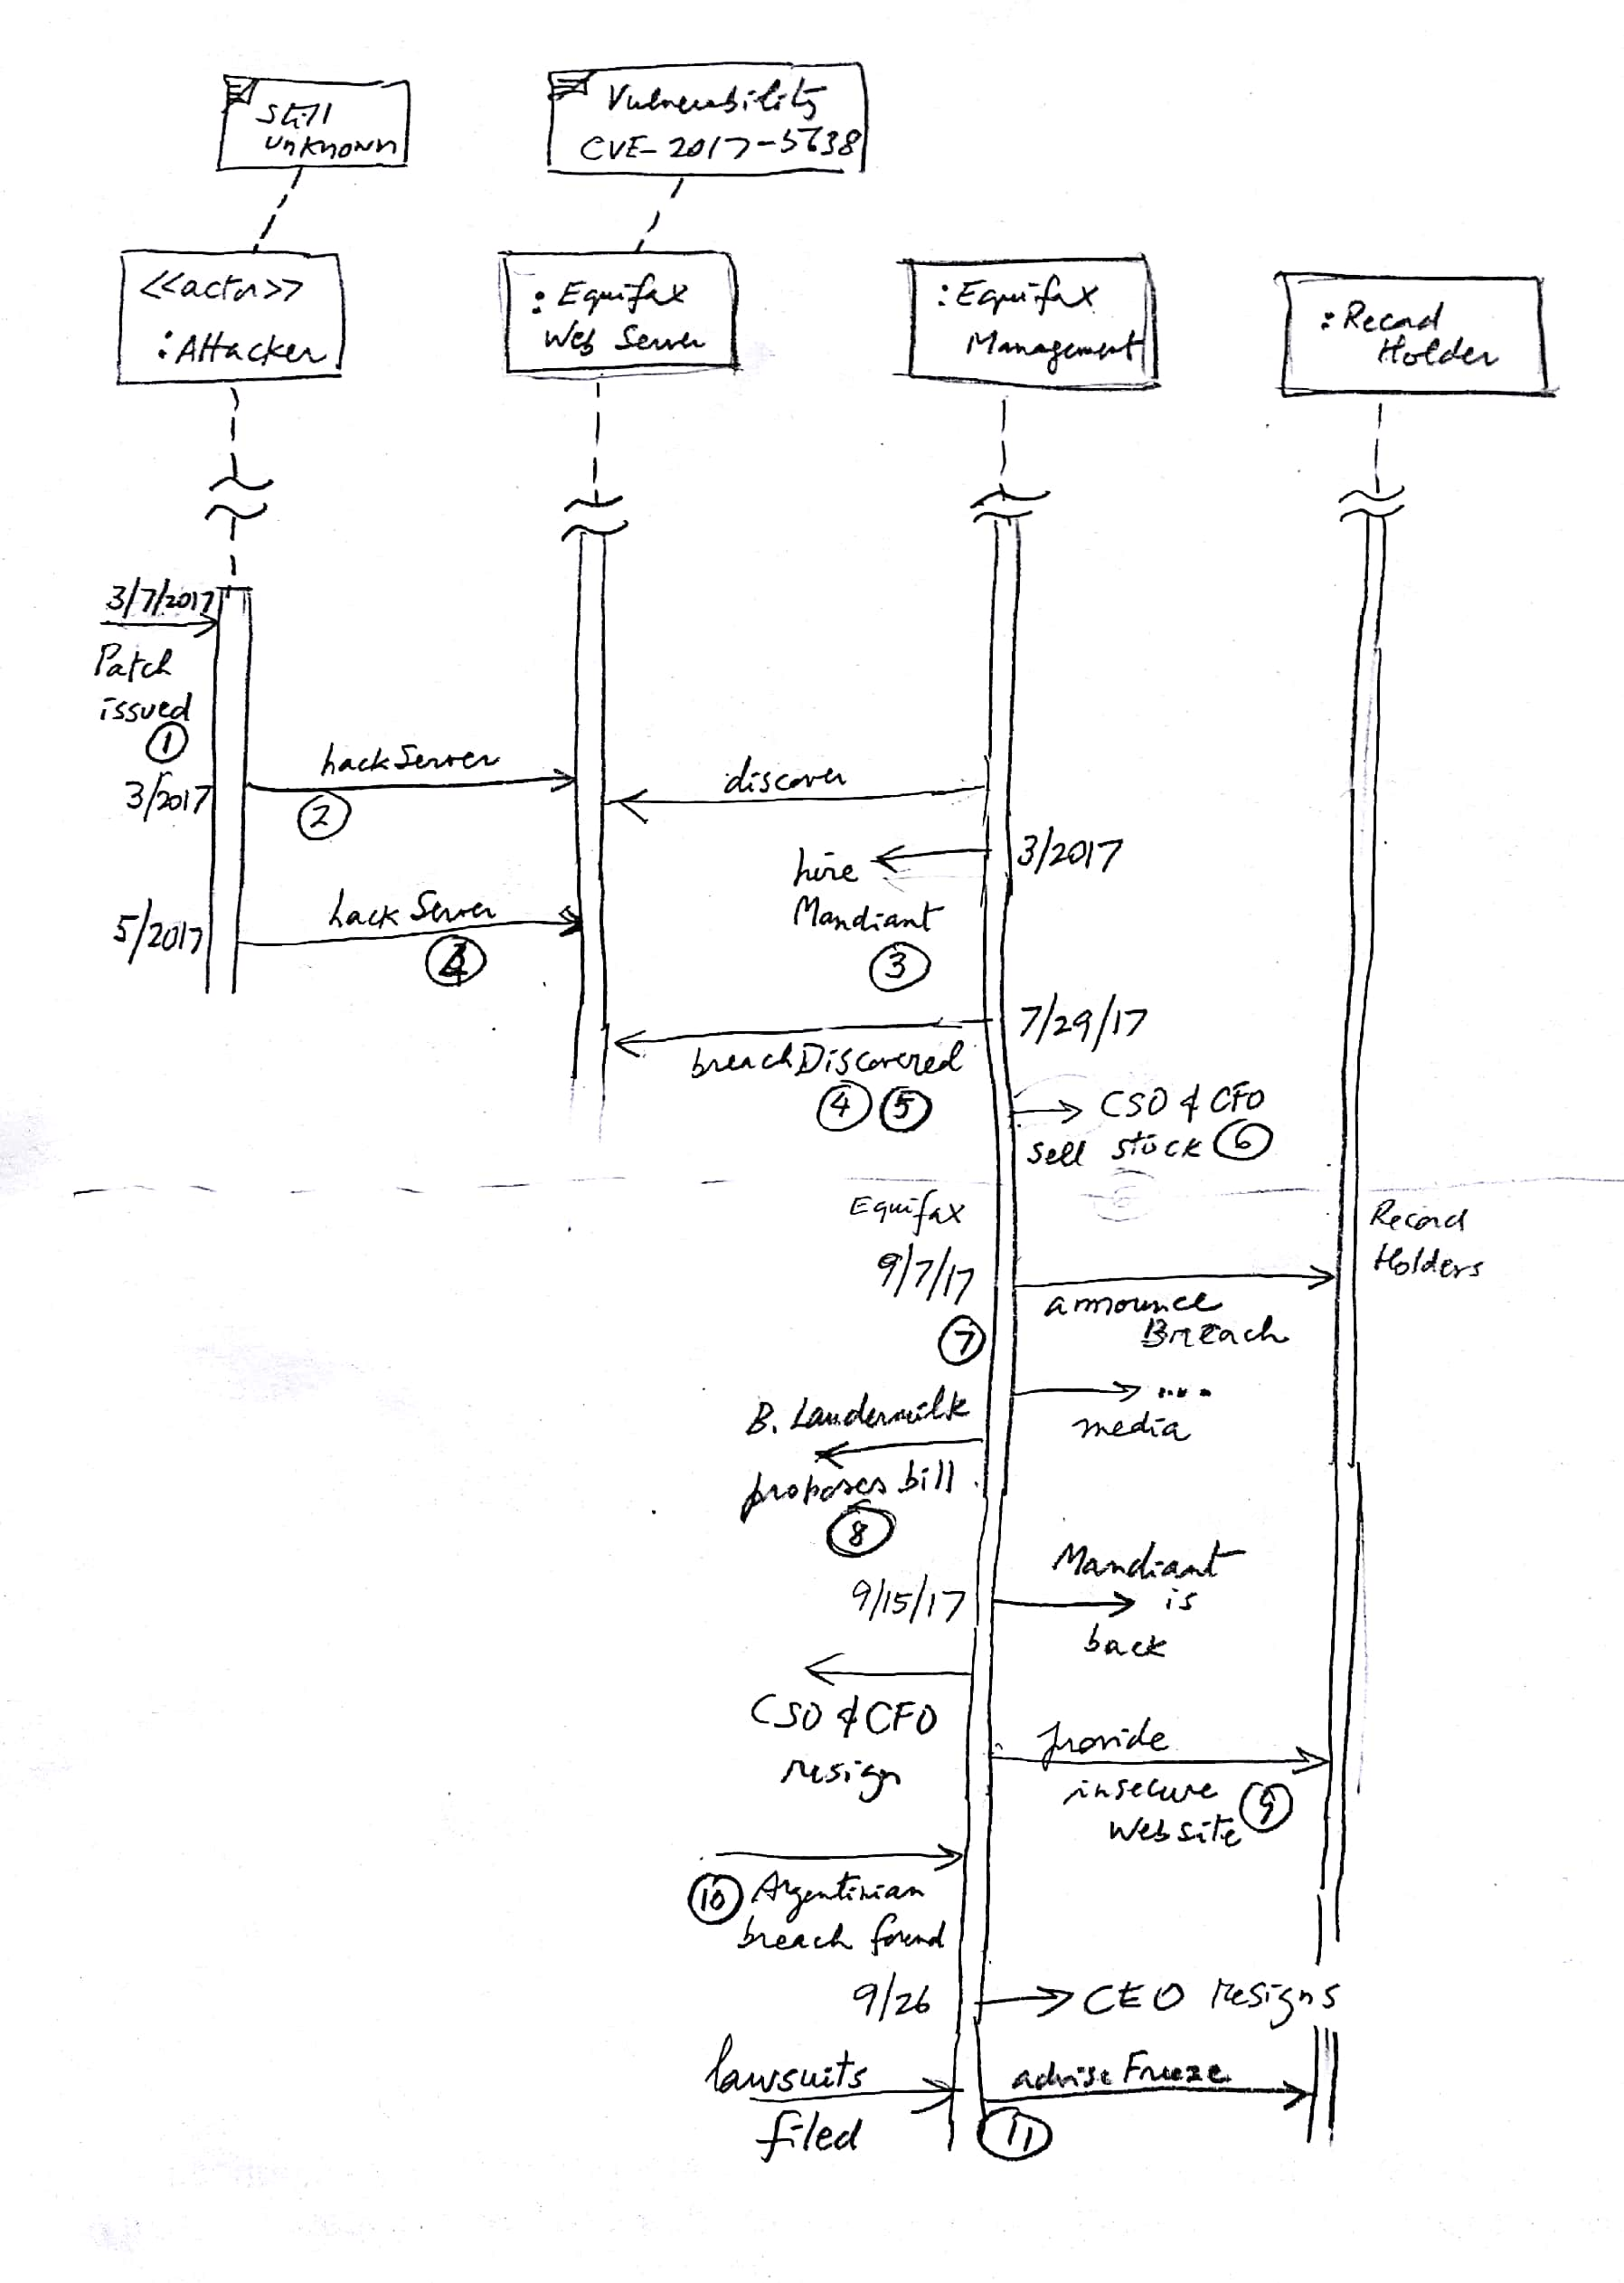

Slide 10
Notes
This and earlier patches were not applied
Equifax said that the earlier intrusion was unrelated to the recent breach but did not offer any details about the information that may have been stolen, or how many people may have been affected. This intrusion may have been carried out by the same party who breached their computer systems again in May. According to Bloomberg, Equifax enlisted Mandiant to assist in investigating the March attack. The same cybersecurity firm was hired following the May-July breach.
Mandiant is an American cybersecurity firm. It rose to prominence in February 2013 when it released a report directly implicating China in cyber espionage. On December 2013, Mandiant was acquired by FireEye.
The data breached included first and last names, SSNs, birth dates, addresses, and more in some cases (credit card numbers, driver licenses). 143 M of records were compromised in the US plus more in the UK, Canada, and Argentina.
Very harmful to record holders (loss of credit, monetary damages, annoyance)

Slide 11
Notes II
6. It was also revealed that three Equifax executives (including the CSO and the CFO)sold $1.8 M of their personal holdings of company shares days after Equifax discovered the breach but more than a month before the breach was made public. The company said the executives "had no knowledge that an intrusion had occurred at the time they sold their shares”. I guess they were just clairvoyant.
7.Other holes were found, including unpatched XSS vulnerabilities, reported to Equifax more than a year ago, and the lack of many basic protections.
8. Congressman B. Laudermilk introduced a bill to reduce consumer protection including capping potential damages in a class action suit to $500,000 regardless of size or amount of loss. It produced outrage and he delayed it (but did not cancel it).

Slide 12
Notes III
9. Equifax offered a website (https://www.equifaxsecurity2017.com) for consumers to learn whether they were victims of the breach. Security experts quickly noted that the website had many traits in common with a phishing website: it was not hosted on a domain registered to Equifax and it had a flawed TLS implementation.
10. Brian Krebs revealed that an Argentinian arm of Equifax had left private data from approximately 14,000 consumers, and more than 100 staff members, openly available.
11. Numerous lawsuits have been filed against Equifax. In one suit the law firm Geragos & Geragos has indicated they would seek up to $70 billion in damages, which would make it the largest class-action suit in US history.
Numerous media outlets advised consumers to request a credit freeze to reduce the impact of the breach

Slide 13
Q2 Vulnerabilities
V1. A CSO without technical knowledge or very lazy. Their CSO had a degree in music and apparently no knowledge of security.
V2. After they were hacked in March they used a security form but still did not patch anything. A clear failure of the CSO.
V3. They were told of XSS and the CVE-2017-5638 Apache Struts vulnerability and given patches. They did not apply them. Again, this is responsibility of the CSO.
V4. The breach was discovered on July 29 but only announced on September 7. This gave time to the attackers to hurt the record holders. This is responsibility of the CEO.
V5. They provided a web site for record holders to check their accounts but this site was insecure, exposing their users to further attacks
V6. There were other vulnerabilities like no secure system design, no authorization in the management interface, use of open source software in a security-critical application (see discussion board).

Slide 14
Common vulnerabilities and exposures (CVE)
Printer-Friendly View
CVE-ID
CVE-2017-5638 | Learn more at National Vulnerability Database (NVD) • Severity Rating • Fix Information • Vulnerable Software Versions • SCAP Mappings
Description
The Jakarta Multipart parser in Apache Struts 2 2.3.x before 2.3.32 and 2.5.x before 2.5.10.1 has incorrect exception handling and error-message generation during file-upload attempts, which allows remote attackers to execute arbitrary commands via a crafted Content-Type, Content-Disposition, or Content-Length HTTP header, as exploited in the wild in March 2017 with a Content-Type header containing a #cmd= string.

Slide 15
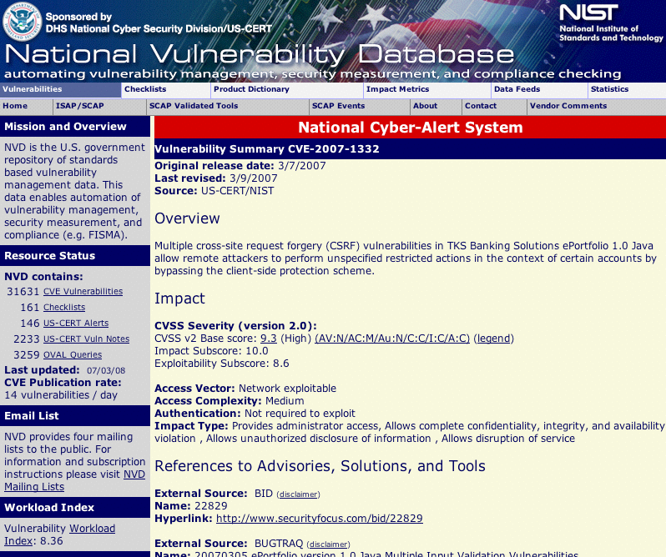

Slide 16
Possible defenses to a similar attack
V1-3 and V6. Have a competent CSO. She should have implemented a systems design for security, a plan to keep aware of vulnerabilities and fix them, and a recovery plan.
V4. Get an ethical CEO. Delaying the announcement of the breach was very harmful to the record holders.
V5. Get a competent and responsible management and security team. They should have not used an insecure web site to let users check their accounts.
V1-3. Free, open-source software is not intended for high security applications like this one. This (and the other aspects above) indicates an emphasis on saving money and lack of concern for their subjects. There are many products in the market that can be used to build a secure system.

Slide 17
References
https://nakedsecurity.sophos.com/2017/09/08/equifax-data-breach-what-you-need-to-know/?utm_source=Naked+Security+-+Sophos+List&utm_campaign=0106671f28-naked%252Bsecurity&utm_medium=email&utm_term=0_31623bb782-0106671f28-455135885
https://en.wikipedia.org/wiki/Equifax
https://www.wired.com/story/equifax-breach-no-excuse/
Fox-Brewster, T. (2017, September 14). How Hackers Broke Equifax: Exploiting A Patchable Vulnerability. https://www.forbes.com/sites/thomasbrewster/2017/09/14/equifaxhack-the-result-of-patched-vulnerability/#4a0e26395cda
http://www.securityweek.com/equifax-shares-more-details-about-breach
https://www.nytimes.com/2017/09/14/business/equifax-hack-what-we-know.html?mcubz=1&_r=0

Slide 18
Typical assignment errors
A verbose essay merging the three questions. Answers should be separated, itemized, precise, and concise.
Ignoring the actions of management and other actors. Security is a whole system problem, not just a technical problem.
Confusing vulnerabilities with events in the attack.
Giving general solutions such as: use authentication, encrypt the database,… We do not know their architecture so for now we can only say “build a secure architecture”. More specific remedies are better: “have a plan for fixing known vulnerabilities”.

